Slide 1
Memory trace analysis between Graph 500 benchmark implementation in C and Java
CSE 506
Home work
By Sahil Jindal, Pruthvi Madugundu

Slide 2
Graph 500 Benchmark
Graph500 is a rating of supercomputer systems, focused on data intensive loads. The benchmark performs the following steps:
Generate the edge list.
Construct a graph from the edge list (timed, kernel 1).
Randomly sample 64 unique search keys with degree at least one, not counting self-loops.
For each search key:
Compute the parent array (timed, kernel 2).
Validate that the parent array is a correct BFS search tree for the given search tree.
For each search key:
Compute the parent array and the distance array (timed, kernel 3).
Validate that the parent array/distance vector is a correct SSSP search tree with shortest paths for the given search tree.
Compute and output performance information.
C – Implementation Github link - https://github.com/graph500/graph500

Slide 3
Graph 500 bench mark – Java implementation
Implemented as part of the HW.
Algorithm supports graph generation and BFS, it doesn’t support Single-source shortest path computation.
It supports Kronecker generator to generate edge pairs. (edgefactor =16)
Graph is constructed and stored in adjacency list.
Scale is a user configured parameter (n), indicating 2^n vertices in the graph. [Currently limited to 2^31-1 vertices due to Java array index limitation].
Once the BFS tracing is done, validation is also performed.

Slide 4
Memory Analysis parameters
Perf tool is used to trace the kernel to the get the memory performance results
Following events/parameters are captured
Page-faults
Mmap() system call
Munmap() system call
L1 Cache load, load misses and store
TLB load and load misses

Slide 5
Execution commands
Graph 500 Parameters – Scale -> 20, Till BFS execution
Recording the Page-faults, mmap() and munmap() events
#perf record -e 'syscalls:sys_enter_mmap,page-faults,syscalls:sys_enter_munmap' java graph500/Graph500 20
#perf record -e 'syscalls:sys_enter_mmap,page-faults,syscalls:sys_enter_munmap' ./graph500_reference_bfs 20
Statistics collection for Cache
#perf stat -e L1-dcache-loads,L1-dcache-load-misses,L1-dcache-stores java graph500/Graph500 20
#perf stat -e L1-dcache-loads,L1-dcache-load-misses,L1-dcache-stores ./graph500_reference_bfs 20
Statistics collection for TLB misses
#perf stat -e 'dTLB-loads,dTLB-load-misses' java graph500/Graph500 20
#perf stat -e 'dTLB-loads,dTLB-load-misses' ./graph500_reference_bfs 20

Slide 6
Inferences of C - Graph 500 implementation
Page faults are very few and concentrated towards the start of program
Total memory allocated is less compared to Java implementation.
Memory allocation are done during graph generation and no allocation later, as per the mmap() events.
All allocated memory is not freed using munmap()
Cache load misses are at -> 5.53% of all L1-dcache hits, this figure is higher in comparison to Java.
TLB load misses are at -> 2.43% of all dTLB cache hits, this figures is higher in comparison to java.

Slide 7
Inferences of Java – Graph 500 Implementation
Page- faults are very high and spread across the execution of the program.
Memory consumption is more in Java and huge chunk is allocated by JVM at the start of execution.
Memory allocation are more spread across compared to C.
Very few memory deallocation done.
Cache load misses are at -> 1.10% of all L1-dcache hits, this figure is lower in comparison to C.
TLB load misses are at -> 0.02% of all dTLB cache hits, this figures is lower in comparison to C.

Slide 8
Plot of Page-faults, mmap() & munmap() events in C

Slide 9
Plot of Page-faults, mmap() & munmap() events in Java

Slide 10
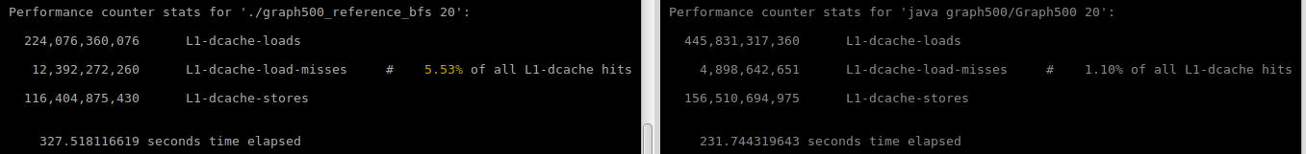
L1 Cache misses
Perf stat result - C Implementation
224,076,360,076 L1-dcache-loads
12,392,272,260 L1-dcache-load-misses # 5.53% of all L1-dcache hits
116,404,875,430 L1-dcache-stores
327.518116619 seconds time elapsed
Perf stat result - Java Implementation
445,831,317,360 L1-dcache-loads
4,898,642,651 L1-dcache-load-misses # 1.10% of all L1-dcache hits
156,510,694,975 L1-dcache-stores
231.744319643 seconds time elapsed

Slide 11
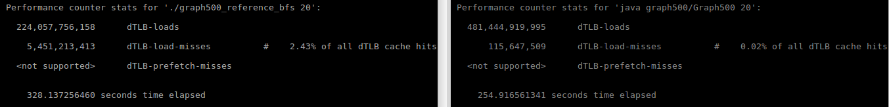
TLB Cache misses
Perf stat result - C Implementation
224,057,756,158 dTLB-loads
5,451,213,413 dTLB-load-misses # 2.43% of all dTLB cache hits
328.137256460 seconds time elapsed
Perf stat result - Java Implementation
481,444,919,995 dTLB-loads
115,647,509 dTLB-load-misses # 0.02% of all dTLB cache hits
254.916561341 seconds time elapsed

Slide 12
Thank You

